Slide 1
PhonePe Transaction Insights
Introduction:
PhonePe is a digital payments and financial services platform in India.
The main objective of your analysis (e.g., user adoption, transactions, insurance trends)

Slide 2
Problem Statement :
To analyze the transaction,insurance and User adoption.
To identify the high performing states, districts and growth opportunities.
Data Source and tools:
Data source (PhonePe Pulse)
Tools used (Python, Pandas, Plotly, PymySQL, Streamlit)

Slide 3
Exploratory Data Analysis
Transactions
Transaction count & amount trends
Payment type distribution
User Adoption
Registered users by state
Top 10 & bottom 10 performing states
Insurance
Insurance count & amount trends
Region-wise adoption

Slide 4
Business Insights:
1.Decoding Transaction Dynamics on PhonePe
2.User Registration Analysis
3.Insurance Transactions Analysis
4.Device Dominance and User Engagement Analysis
5.Transaction Analysis Across States

Slide 5
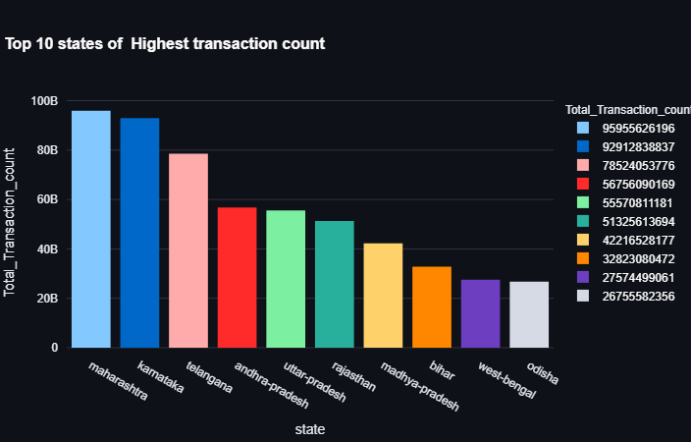
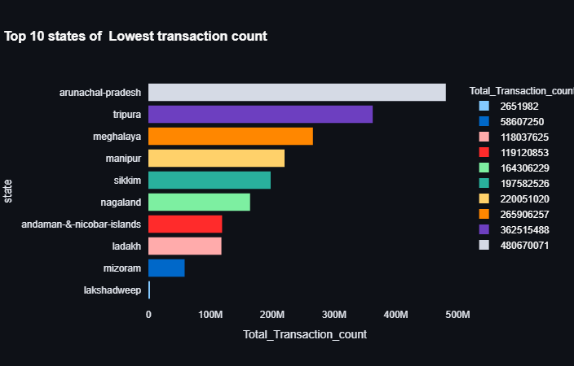
Visualizations: Bar chart,pie chart,map,donut chart, Line chart
Transaction count:

Slide 6
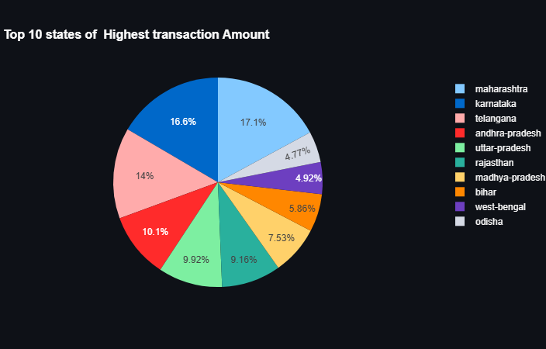
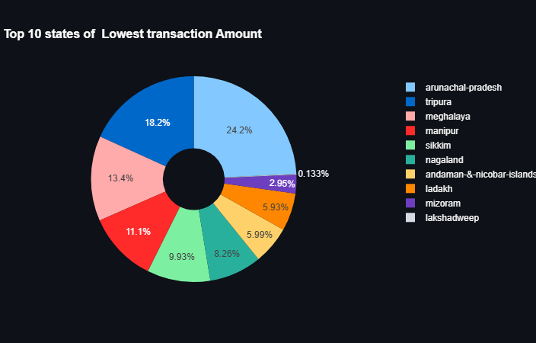
Transaction Analysis Across State:

Slide 7
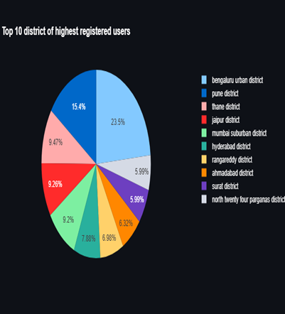
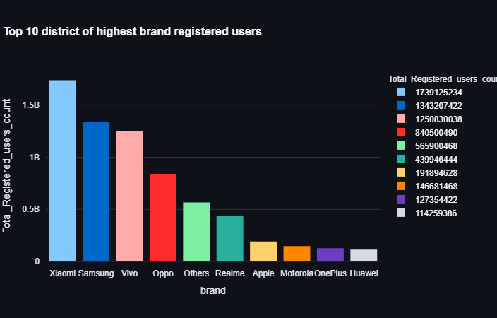
Registered Users:

Slide 8
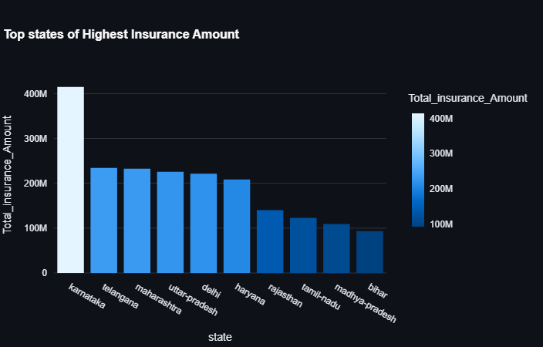
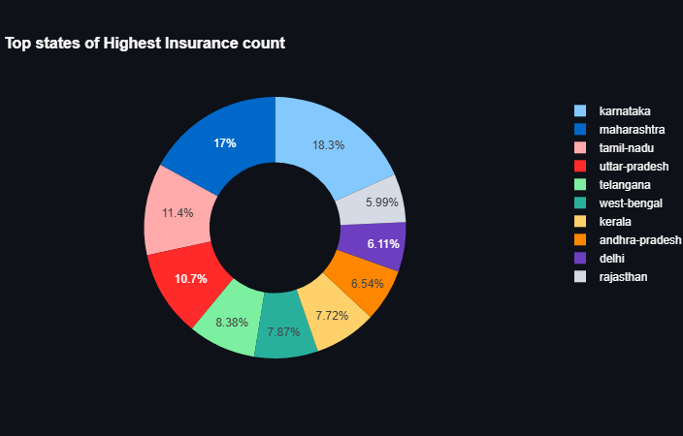
Insurance Count and Amount:

Slide 9
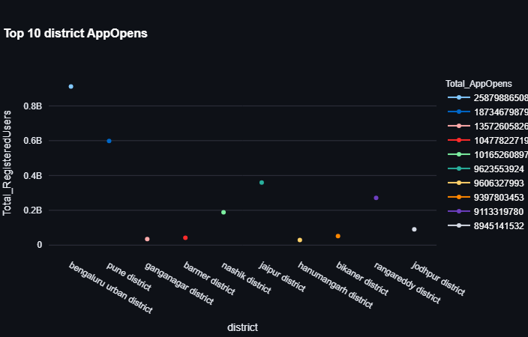
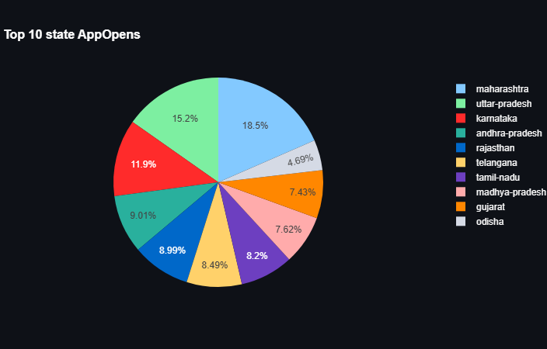
Device Dominance and User Engagement Analysis:

Slide 10
Recommendations:
Run targeted cashback or offers during peak seasons to boost engagement further.
Offer signup bonuses or referral rewards in low-adoption states.
Educate users in rural areas about low-cost insurance benefits.
Educate users in rural areas about digital services through phonepe and benefits.
Introduce some additional benefits for their families with high transaction categories like mobile recharge or any bill payments.
Focus marketing in top states with digital adoption trends.
For high marketing get partner with fast networking states and districts e-commerce and service providers.

Slide 11
Submitted by: Kanimozhi

